Slide 1



November 2025
Verification of merAB sequences
Isabel Sanz-Sáez
Workshop hands-on Session

Slide 2
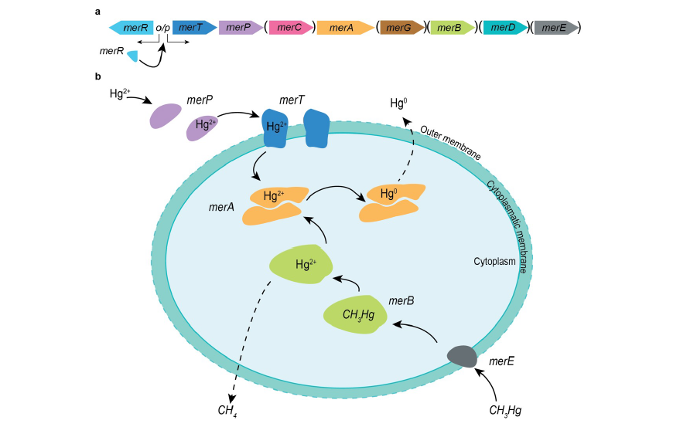
The mer operon
merA
(mercuric reductase)
Hg²⁺
Hg⁰
merB
(organomercurial lyase)
CH3Hg
Hg²⁺
modified from Boyd and Barkay (2012), Front. Microbiol.
Notes:
Biotic demethylation is mainly mediated by the mer system.
The mer operon consists of a variety of genes including the regulator (merR), different transporters, and the main enzymes merA and merB. MerA is mercuric reductase that transform divalent mercury intro elemental mercury and merB is an organomercuryal lyase that demethylates methylmercury.

Slide 3
The mer operon
merA
(mercuric reductase)
Hg²⁺
Hg⁰
Evolved from high temperature hydrothermal environments
merA-encoding cells have a fitness advantage in Hg(II) contaminated environments
merB
(organomercurial lyase)
CH3Hg
Hg²⁺
Recruited relatively recently and probably originated in mesophile rather than in thermophiles where merB homologs are absent
Higher presence in habitats with higher concentration of MeHg
modified from Boyd and Barkay (2012), Front. Microbiol.
Notes:
It is hypothesized that merA evolved from high temperature hydrothermal vents where Hg concentrations where elevated and the presence of this gene is demonstrated to have a clear fitness advantage specially in contaminated environments. (Evolved from ﬂavin-dependent disulﬁde oxidoreductases).
Unlike merA, merB has been hypothesisez to be recruited recently in the operon and from a mesophile origin. Probably it has been acciquired when antropogenic activities had led to an increase of MeHg concentrations, there is actually a higher presence in MeHg contaminated evironemenst. Also, it has been hypothesized that MerB evolution relates to cohabitation with MeHg- forming taxa and, thus, a possible role in detoxiﬁcation.
The only homology known for MerB is a partial structural homology to NosL, a Cu(I)-binding lipoprotein which is a part of the nitrous reductase system;80 both enzymes share two “treble-clef”-like structures, typical to TRASH domains, in their active core.

Slide 4
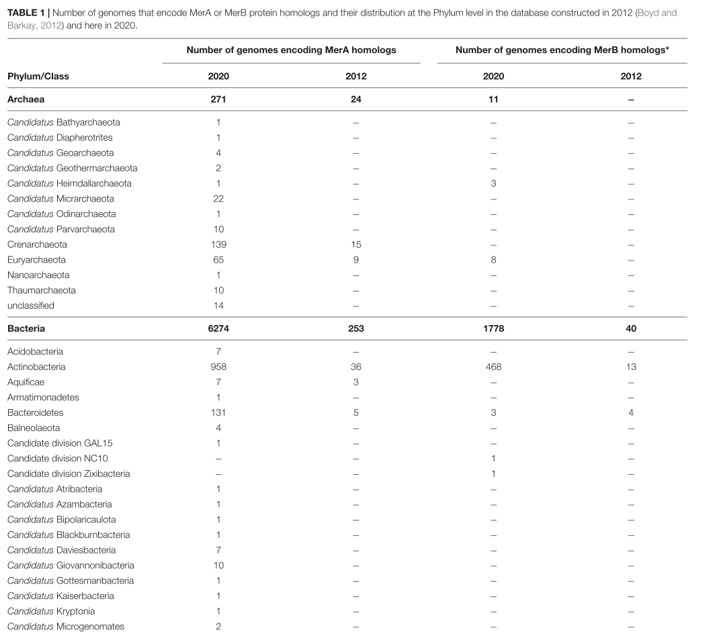
High sequence diversity
…
Christakis et al. (2021), Front. Microbiol.
Notes:
merA and merB genes have been detected in a wide variety of taxonomic groups with a high sequence diversity which difficults clearly its identificatn in environmental samples.

Slide 5
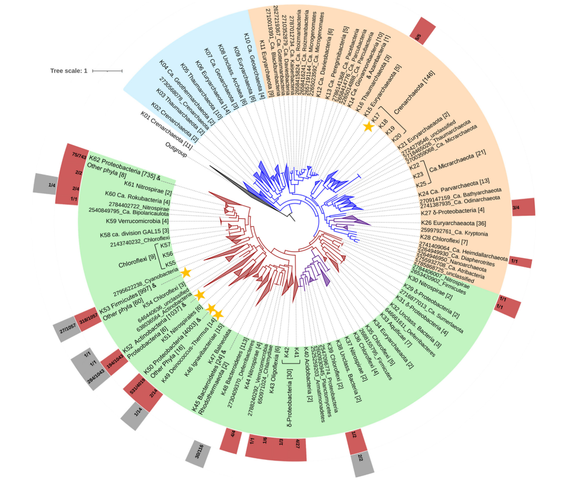
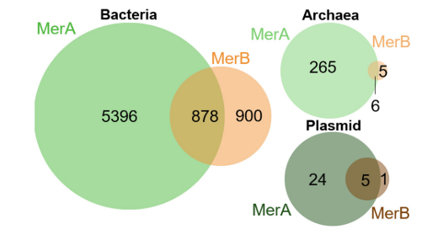
Not all genomes code for both genes
merA
merB
Number of genomes encoding merA and/or merB
Christakis et al. (2021), Front. Microbiol.
Notes:
Also, we have seen that not all genomes encode for both genes. As you can see in both the Venn diagram and the tree there are taxa coding only merA and others only merB.

Slide 6
Not all genomes code for both genes
merA
merB
General: 80/20 merA/merB ratio
Sediments: 30/70 merA/merB ratio
Is the identification of merAB genes affected by the sites that we have studied?
Christakis et al. (2021), Front. Microbiol.
Notes:
Also, we have seen that not all genomes encode for both genes. As you can see in both the Venn diagram and the tree there are taxa coding only merA and others only merB.
Difference in merA and merB ratio depending on the environment.

Slide 7
Not all genomes code for both genes
merA
merB
Is it necessary to have both genes for activity?
Alternative reduction pathways with absence of merA?
Alternative demethylation pathways in the absence of merB?
Number of genomes encoding merA and/or merB
Christakis et al. (2021), Front. Microbiol.
Notes:
Read the questions.

Slide 8
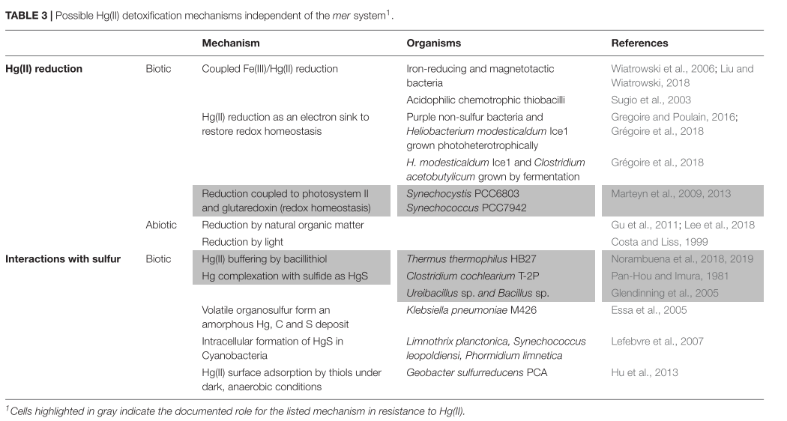
Alternative methods for Hg(II) detoxification
Christakis et al. (2021), Front. Microbiol.
Notes:
In this review of Christakis and colleagues they summarize in this table possible Hg(II) detoxification mechanisms independent of mer system, thus, when merA is absence. Because they found that merB is more oftern found alone in the operon than previouslt though where merA was more commonly found without the merB gene.

Slide 9
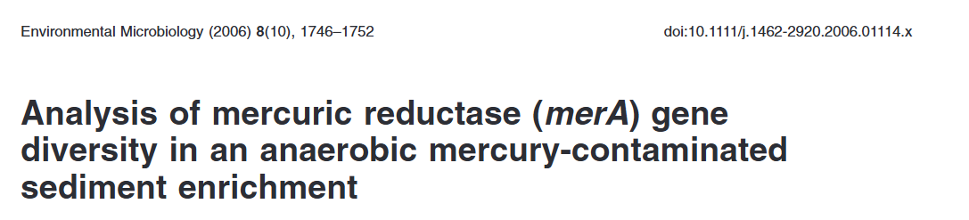
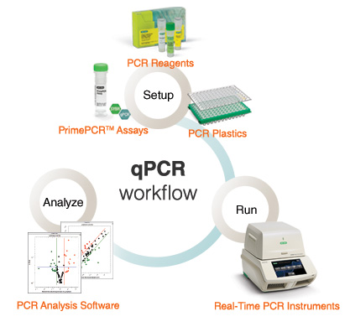
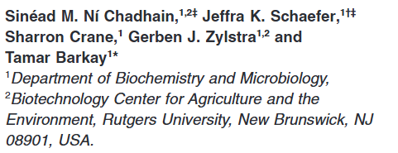
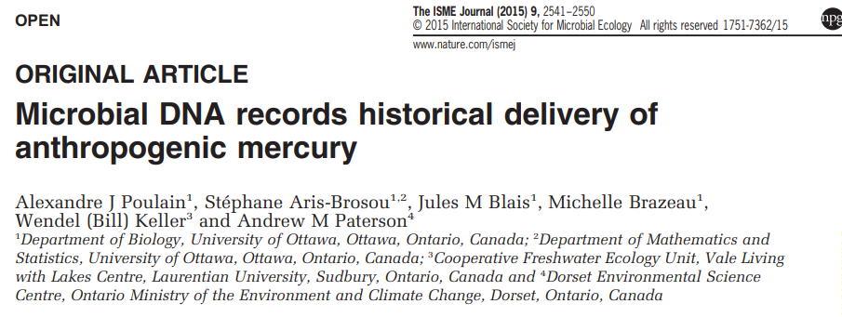

How to detect those genes?
PCR and qPCR
Notes:
Despite this we want to focus in the seminar on how merA and merB genes have been identified in different studies and the methodologies available.
I will show two main methods, each of them have their own pros and cons. The first one is based on PCR and qPCR detection. There are different published studies using this methodolohy to detect mainly merA genes from different environemtns.

Slide 10


How to detect those genes?
PCR and qPCR
Metagenomics and metatranscriptomics
Who is there?
Putative function?
Who is active?
Notes:
On the other hand we have metagenomics and metatranscriptomics which allow you to sequence all genes available in a sample and later identify the specific merA and merB genes.

Slide 11
How to detect those genes?
Pros and cons of the different methods
Feature | PCR/qPCR | Metagenomics/Metatranscriptomics
Sensitivity | High sensitivity for known mer genes | Can detect a broader range of mer genes but may miss low-abundance targets
Specificity | Very high; targets specific mer genes | Lower specificity; detects all genes, including potential false positives
Detection of Novel Genes | Limited to known sequences | Can identify novel mer genes and variants
Complexity of Analysis | Straightforward; requires primers | Computationally complex; requires bioinformatics expertise
Cost | Relatively low | Higher cost due to sequencing and analysis requirements
Time Required | Fast (hours) | Slow (weeks to months for sequencing and analysis)
Sample Requirements | Requires minimal DNA/RNA | Requires larger amounts of high-quality DNA/RNA
Bias & Limitations | Primer-dependent; may miss variants | Potential for sequencing bias; dependent on database accuracy
Notes:
Pros and cons of the tow methods

Slide 12
How to detect those genes?
PCR and qPCR
Metagenomics and metatranscriptomics
Who is there?
Putative function?
Who is active?
Notes:
For this seminar we focus in the second one

Slide 13
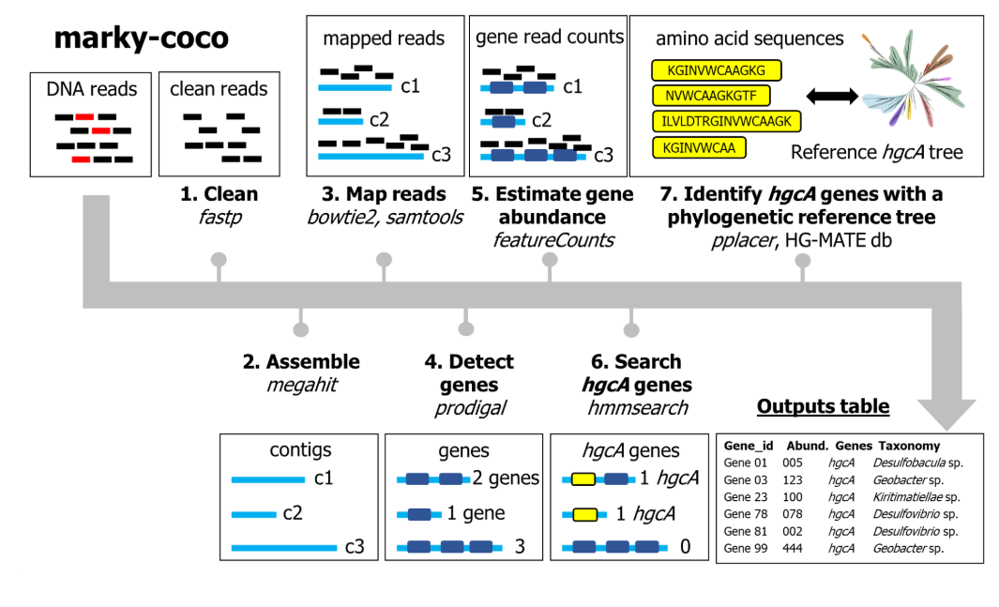
Pipelines already available for identification
Based on the construction of Hidden Markov Models (HMM)
Marky-coco 2 alpha
Can be applied also to
merA and merB genes
https://github.com/ericcapo/marky-coco
Notes:
There is also a public available pipeline that allows you to detect merA and merB genes from raw metagenomic and metatranscriptomics data. This pipeline was first designed to detect hgcAB genes but has been updated to be able to also detect mer genes. As you see is also based on the construction of HMM. The output will be a table with the genes detected and the abundance of each sequence in the different samples you analyze. In this pipeline also it allows you to do a taxonomic classification based on a reference phylogenetic tree. With this pipeline we get detection of merA and merB genes but not verification if they are true genes or not based on the presence of essential amonoacids. One could do some manual verification but this is time-comsuming so there are also different attemps to develp tools for the verification.

Slide 14
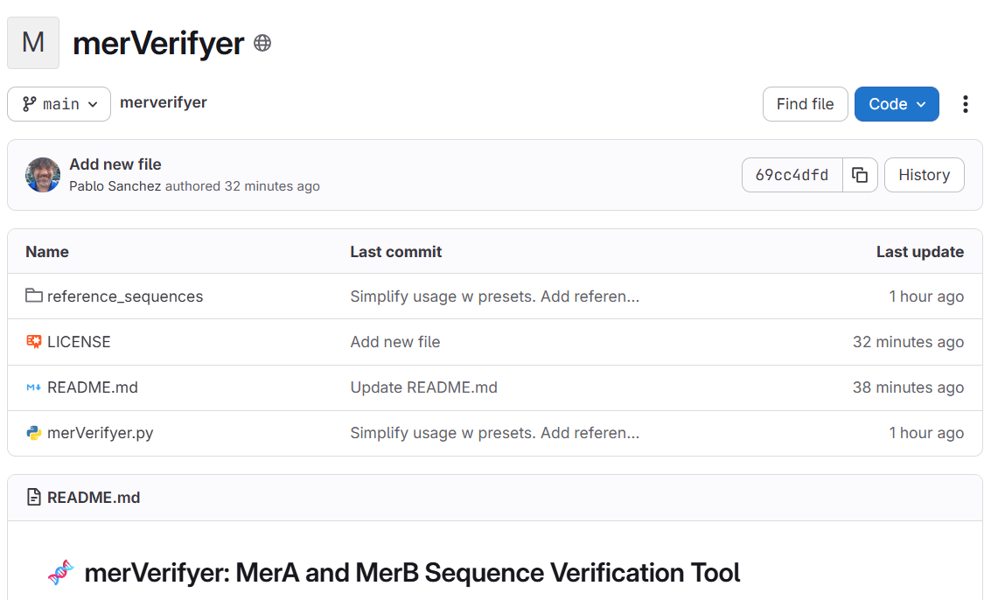
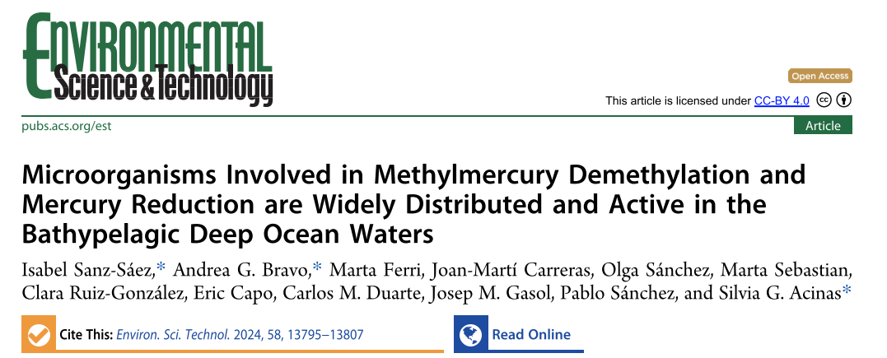
Methods already available for verification
Based on the identification of essential amino acids
https://gitlab.com/pablo.sanchez/merverifyer
Notes:
This tool: merVerifier allows you to use a reference sequence and specify the positions of the essential aminoacids that you consider are necessary for the detection of the genes. This tools has been used for the detection and verification of merA and merB genes from a global deep ocean database published recently.

Slide 15

Other methods for verification
To explain by Nicola
Alignment at a nucleotide level with reference sequence
Build a score table based on amino acid position
The result in the outcome are sequences that have:
1) high sequence similarity with known reference gene sequences
2) possess known essential functional AAs in the "right" position
Nicola Gambardella
PhD Candidate at University of Porto, Portugal
Will be published soon
Notes:
As far as I know there are also other groups working on this, for example Nicola is working in a similar system based on an aligment with a reference sequence and position of essential aminoacids building a score table.

Slide 16

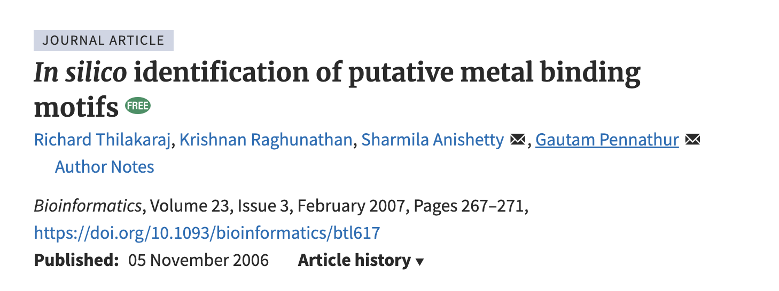
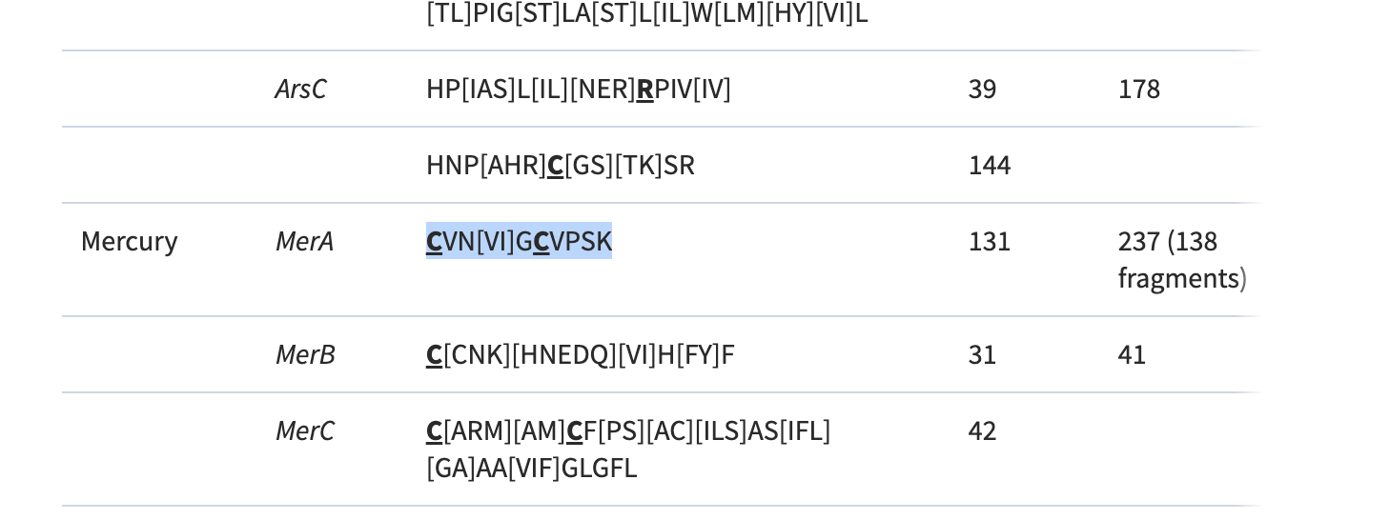
Other methods for verification: merA
Zohra Zahir
PhD Candidate University of Regina, Canada
C[VL]N[V/T/I/Y]GCVPSK
Notes:
Other colleagues, are also using alternative methods.
For merA, I’ve noticed the motif C[VL]N[V/I/L/T]GCVPSK seems to be a good search motif in metagenomic data.

Slide 17
How to apply the merVerifier
3) Be sure which essential aminoacids you want to use for your verification:
For merA (Boyd & Barkay, 2012) :
two cysteines at positions 207 and 212
vicinal cysteine pair at the carboxy terminus, positions 628–629
tyrosine at position 264
and either a tyrosine (for bacteria) or a phenylalanine (for archaea) at position 605.
For merB (Lafrance-Vanasse et al., 2009; Wahba et al., 2016, Pitts & Summers, 2002):
cysteines at positions 96 and 159
asparagine at position 99
Optional cysteine at position 117 → described as having a potential structural role.
1) Download python code from here:
https://gitlab.com/pablo.sanchez/merverifyer
2) Prepare your input data → FASTA files AA of your suspected merA and merB sequences extracted from Marky-coco

Slide 18
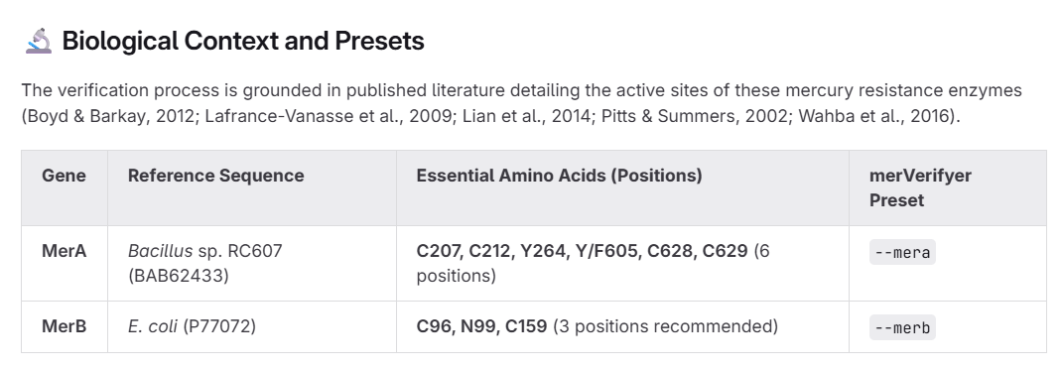
How to apply the merVerifier
3) Be sure which essential aminoacids you want to use for your verification:
For merA (Boyd & Barkay, 2012) :
two cysteines at positions 207 and 212
vicinal cysteine pair at the carboxy terminus, positions 628–629
tyrosine at position 264
and either a tyrosine (for bacteria) or a phenylalanine (for archaea) at position 605.
For merB (Lafrance-Vanasse et al., 2009; Wahba et al., 2016, Pitts & Summers, 2002):
cysteines at positions 96 and 159
asparagine at position 99
Optional cysteine at position 117 → described as having a potential structural role.
1) Download python code from here:
https://gitlab.com/pablo.sanchez/merverifyer
2) Prepare your input data → FASTA files AA of your suspected merA and merB sequences extracted from Marky-coco

Slide 19
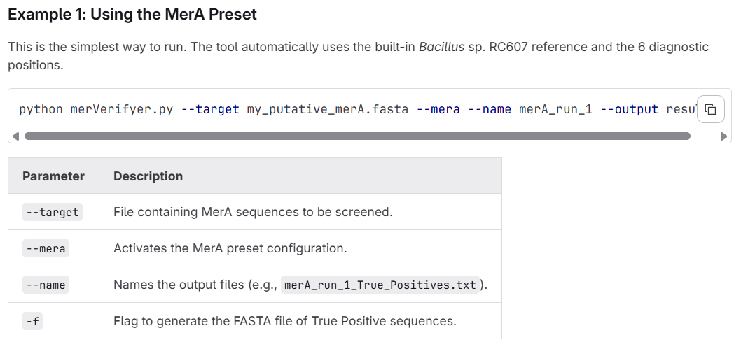
How to apply the merVerifier

Slide 20
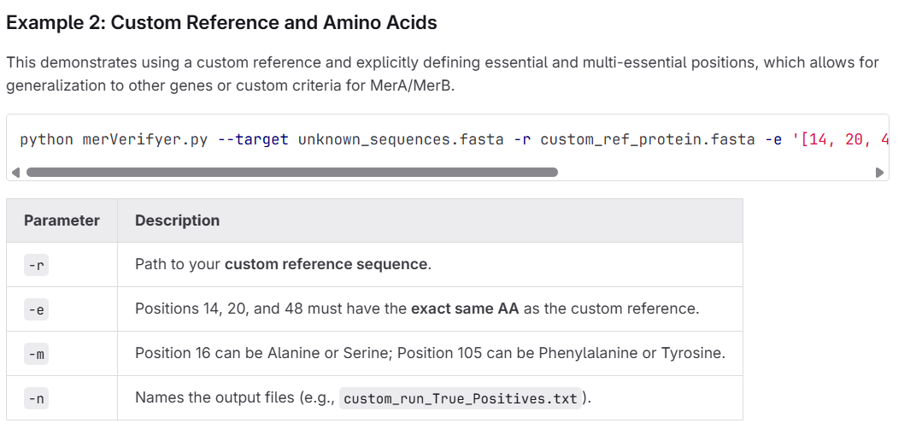
How to apply the merVerifier
python merVerifyer.py --target unknown_sequences.fasta -r custom_ref_protein.fasta -e '[14, 20, 48]' -m '16:A|S;105:F|Y' -n custom_run -o custom_results/

Slide 21
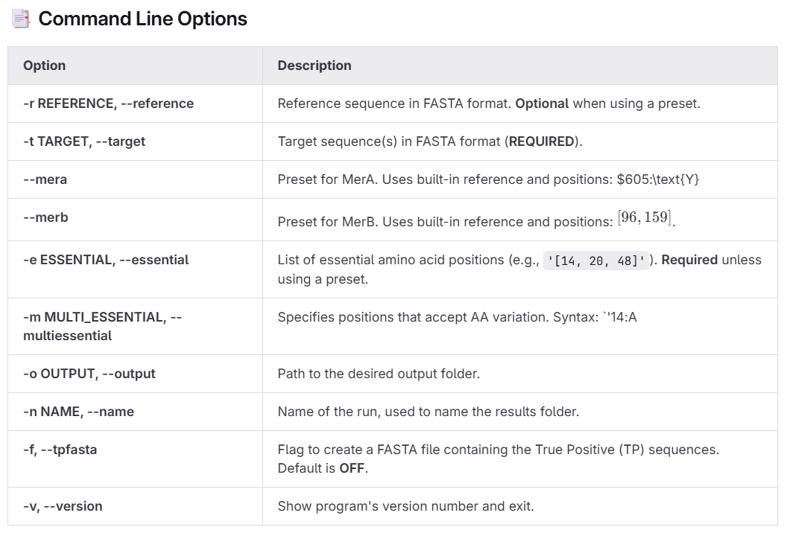
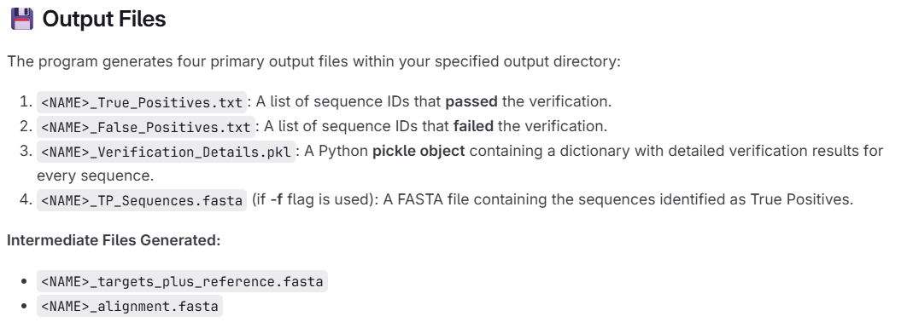
How to apply the merVerifier

Slide 22
WHAT IS A TRUE MERA OR MERB?

Slide 23
OPEN QUESTIONS
Are we too strict to avoid false positives?
Are our identifications biased based on the databases we have?
Are we sure that we can exclude samples that detect merB but not merA?
Should we consider other reference sequences based on environment or taxa?
How much is it known about the alternative pathways for demethylation and reduction of Hg(II) to Hg(0)? Should we include this pathways more in our studies?

Slide 24
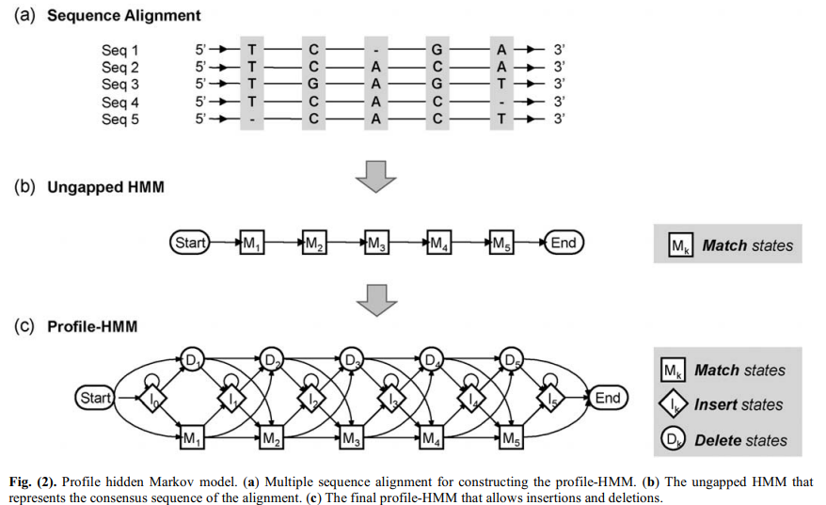
Hidden Markov Models (HMM) + essential amino acids
HMM is a statistical model to identify specific patterns in DNA or RNA based on already available sequences in databases
Essential amino acids:
merA
C 207-212
Y 264
Y/F 605
C 628-629
merB
C 96
C 117 * structural?
C 159
N 99
Bacillus cereus RC607; BAB62433.1
Escherichia coli plasmid R831b; AAB49639.1
Cristakis et al. 2021, Frontiers in Microbiology
Barkay and Gu et al. 2022, ACS Environ.
Notes:
Mainly what we do is to construct HMM based on sequence that are already available in databases. HMM are a statistical model that allow us to detect specific patterns in dna/rna data and identify our desired genes of interest. Later, because we know that merA and merB have specific aminoacids that are essential for them to be functional we could use reference sequence and the position of this essential aminoacids to go a step further and verify our detected sequences.

Slide 25
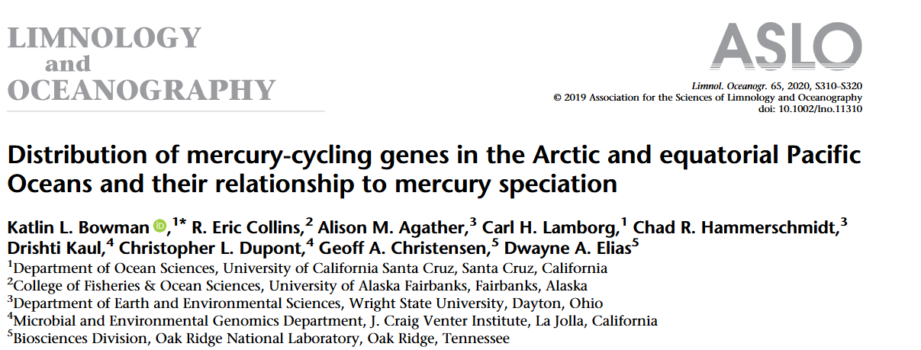
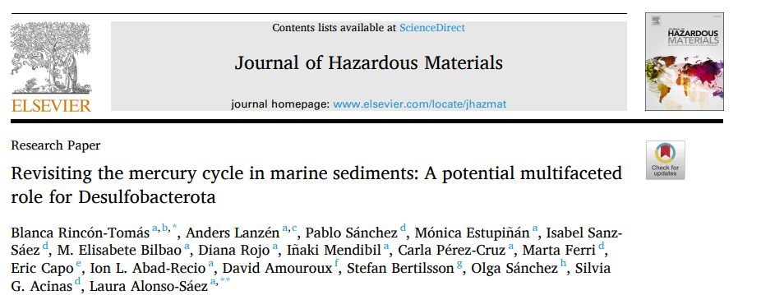
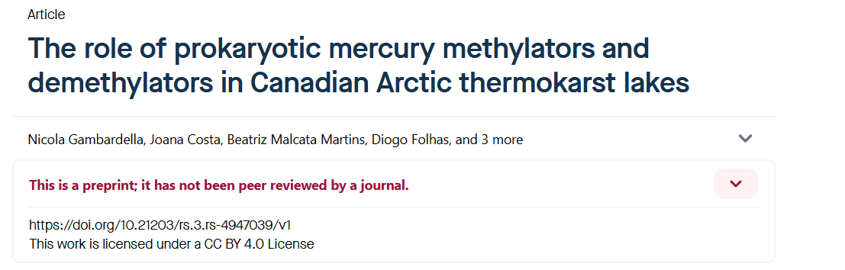

Different tools in different papers
Based on the construction of Hidden Markov Models (HMM)
Notes:
There are a variety of papers using omics approaches for the detection of mer genes in different environments and mainly they are based on the construction of this HMM

